Slide 1

Final presentation
Kevin MulraneyA00249365

Slide 2
Overview of presentation
Sprint 1 and 2 overview plus what I achieved
Demo of final build
Conclusion and questions

Slide 3
What is it?
Smart fridge convertor
Low cost
Easily accessible

Slide 4
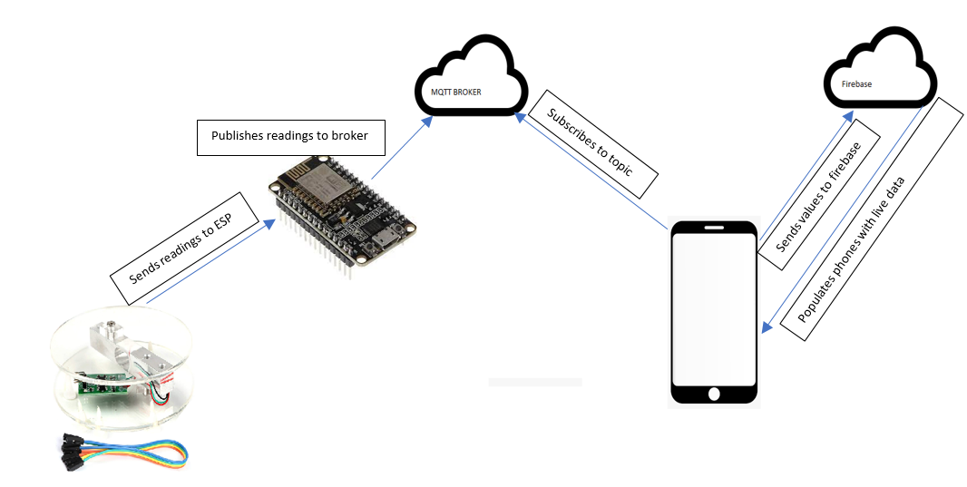
Overview of build

Slide 5
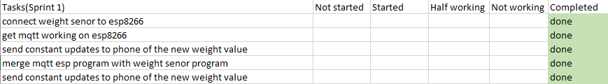
Sprint 1
Focused on:
Getting the weight sensor to work
Getting MQTT up and running on the ESP
Establishing a connection between ESP and App via broker

Slide 6
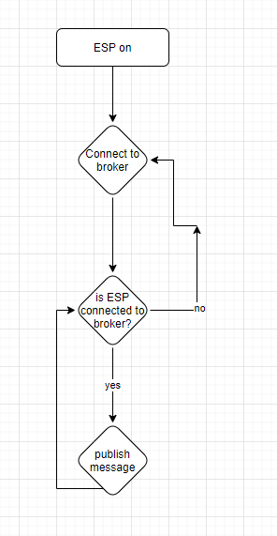
Sprint 1 additional notes and issues
Constantly losing connection on the emqx broker
Switched to MaQiaTTo broker
Issue came back

Slide 7
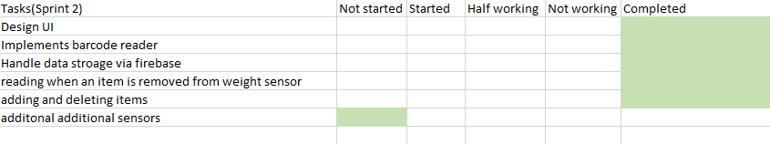
Sprint 2
Focused on:
Handling of data
UI design
How to store data and support multiple instances
How to add and remove items
Added a way of categorizing the data via barcode scanner

Slide 8
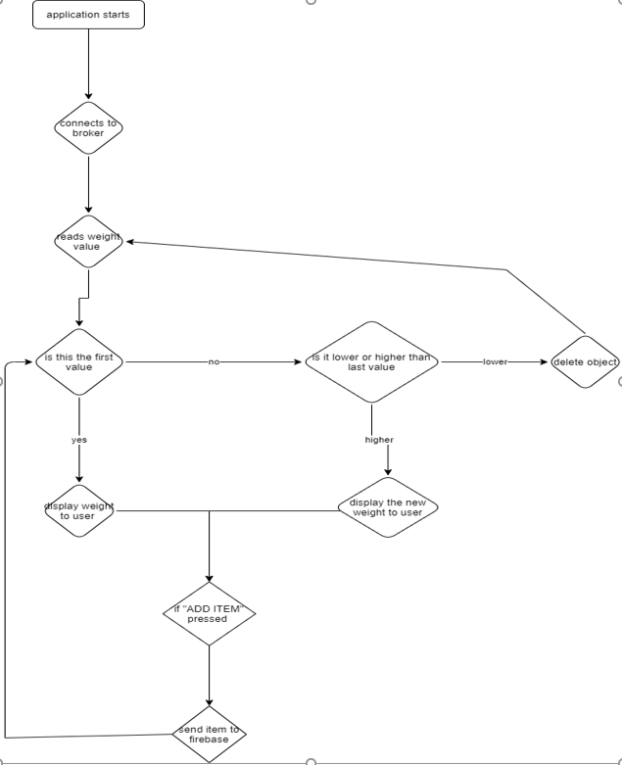
Sprint 2 additional notes and issues
Didn’t get to implement additional sensors in time so had to omit them
Logic for weight sensor and firebase functionality

Slide 9
Demo of final build
Barcode section

Slide 10
Conclusion and final thoughts

Slide 11
Price
Core Parts:
ESP price: 4.50 each
HX711 Price: 7.50
Core total: 12.00
Additional parts:
Jumper cables price: 4.00
Battery bank: 10.00
Total cost: 26.00

Slide 12
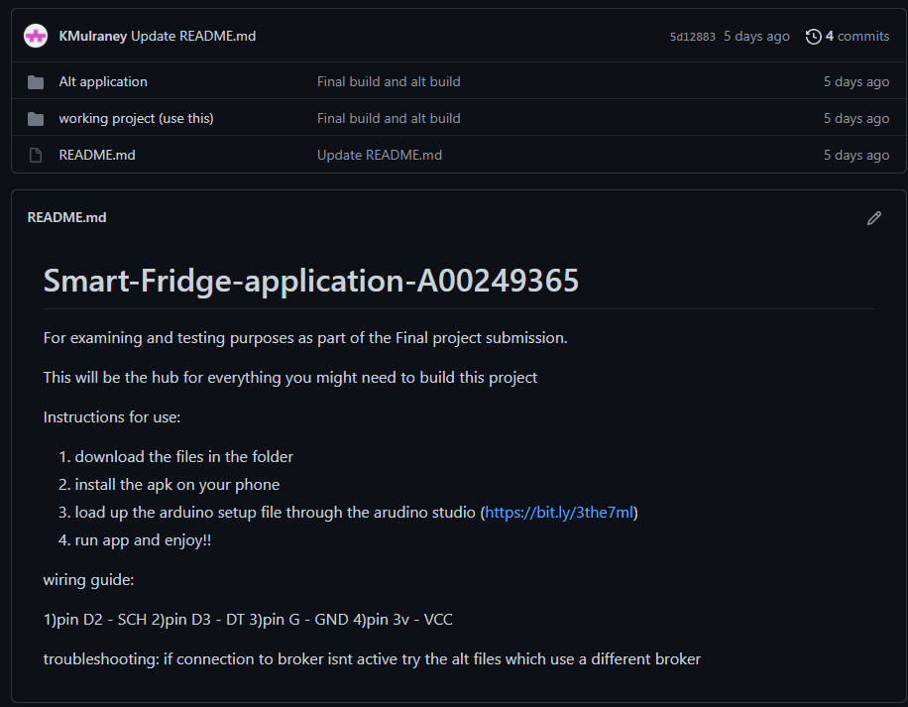
Accessibility
Added APK as well as code for additonlal development or instant set up

Slide 13
Take a ways from project
More experience with technologies I have used before
More experience with importing libraires or use into android
Additional experience with reading documentation to learn new skills

Slide 14
Thanks for listening
Any questions?

